Slide 1
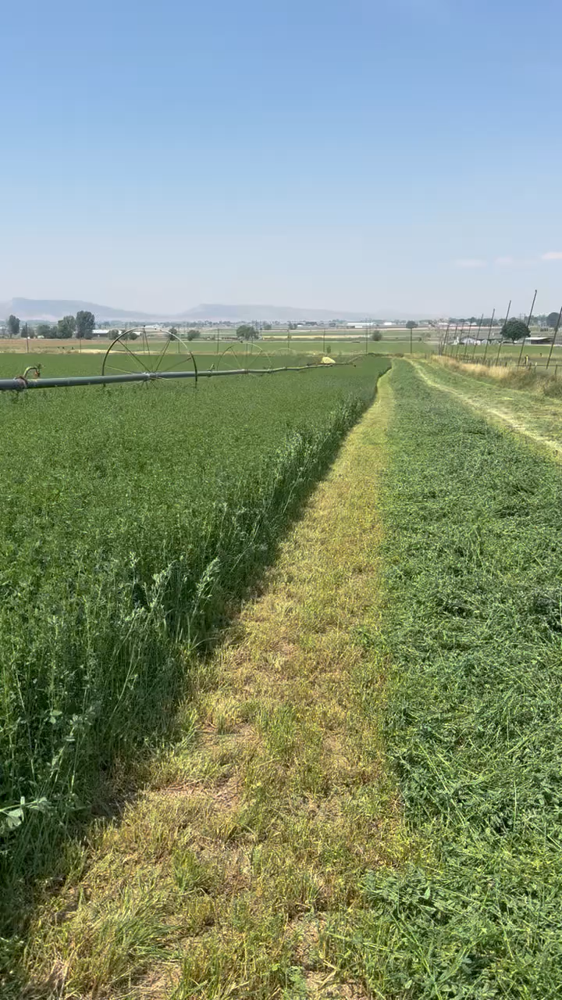
Ed Millard’s Alfalfa Farm in Colorado

